Slide 1
Link View Trọn Bộ
https://lazinet.com/projects/aLuu-BKHN-TSN/Logo-BKHN-TSN
Link Google Drive
https://drive.google.com/drive/u/0/folders/15AHZUH-PUHx7awt9Jjrav9rDsteSLjBX

Slide 2
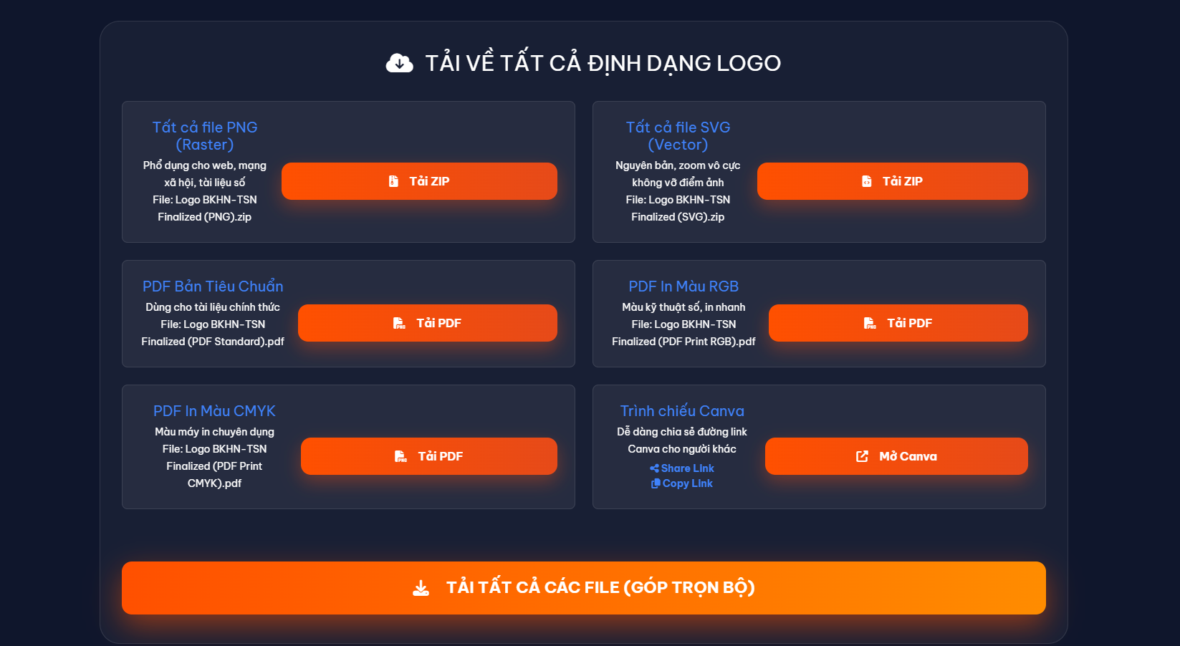

Slide 3
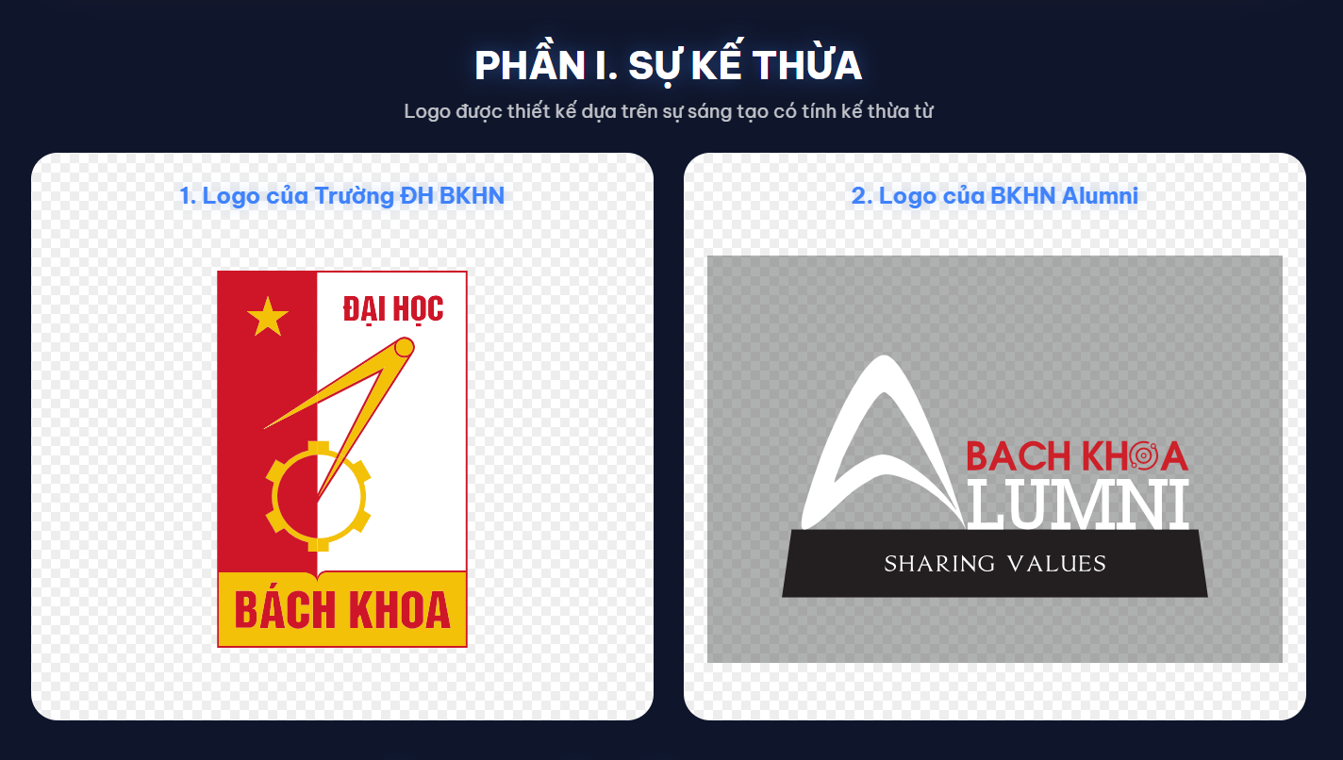

Slide 4
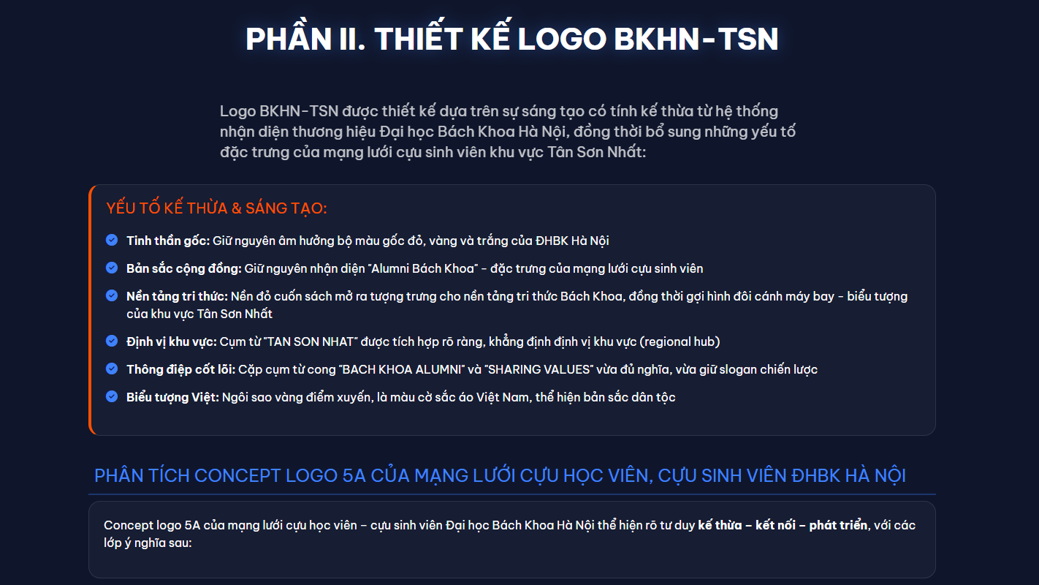

Slide 5
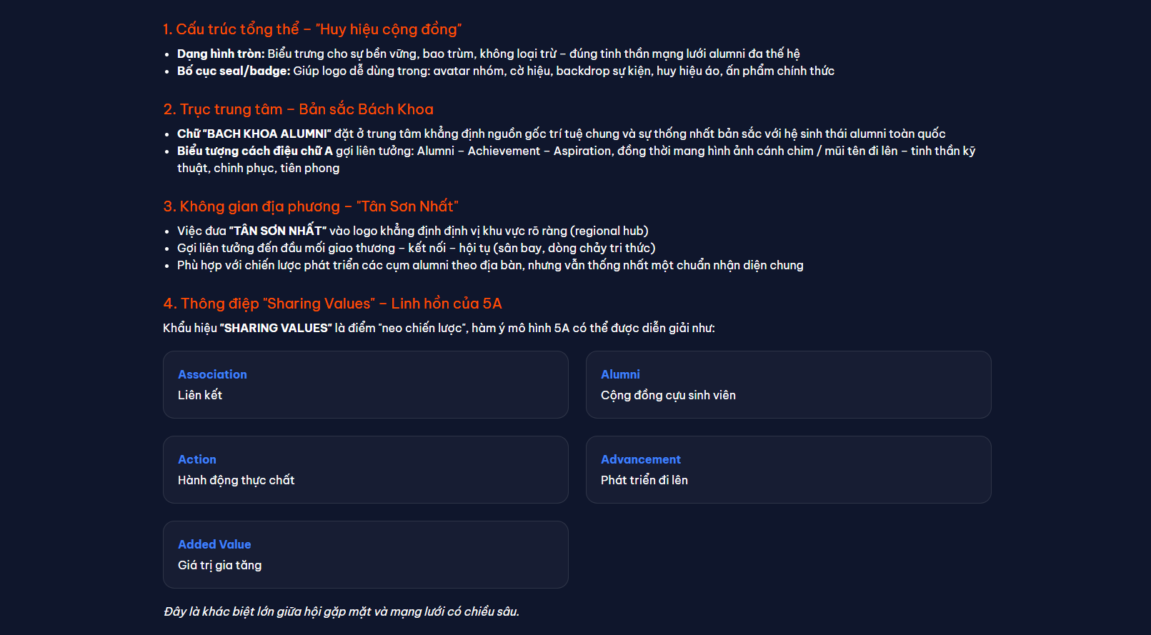

Slide 6
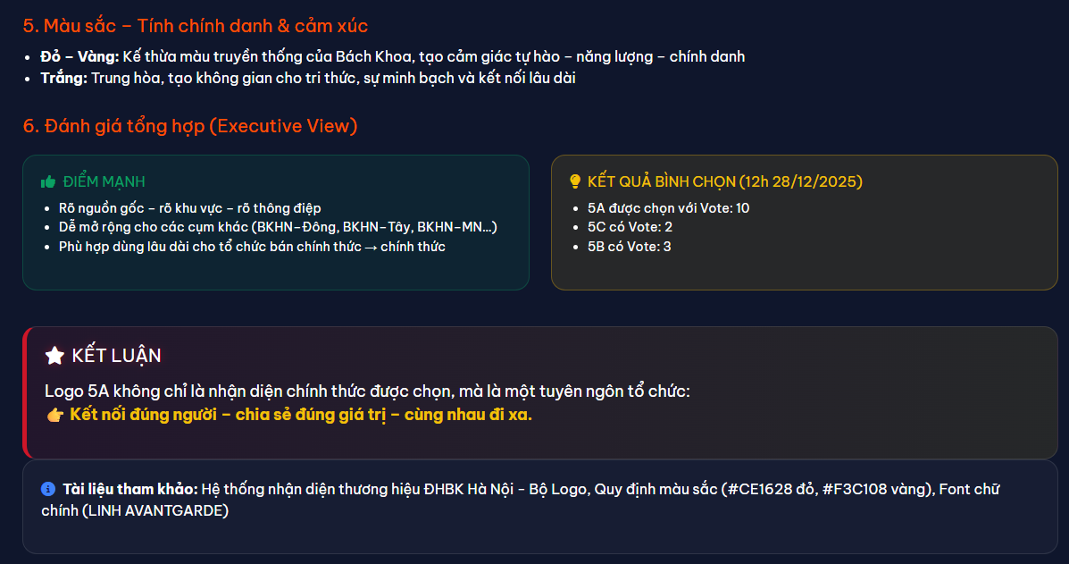

Slide 7


Slide 8


Slide 9


Slide 10


Slide 11
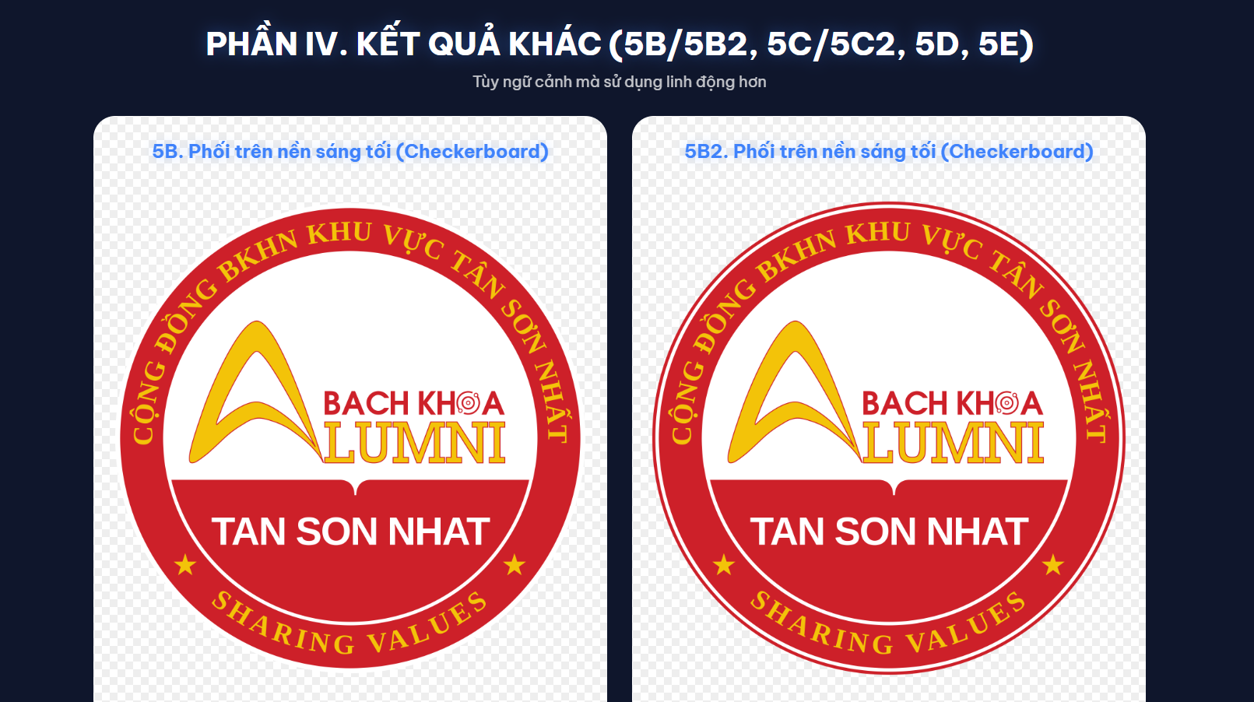

Slide 12


Slide 13


